Slide 1
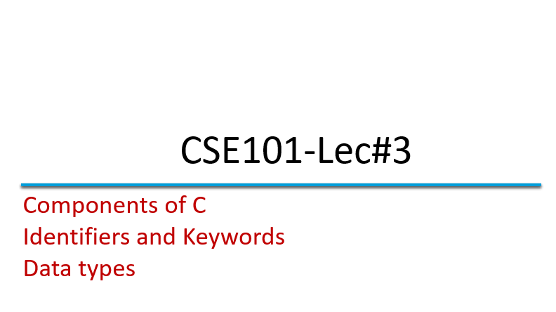
#2

Slide 2
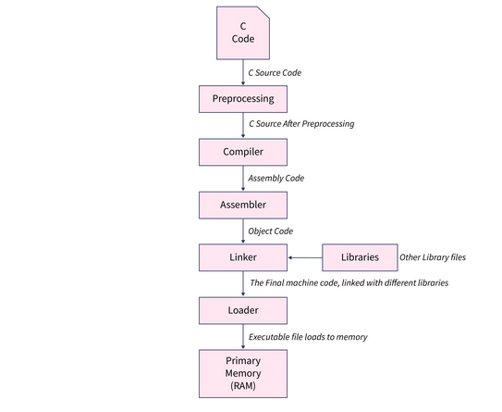
C compiler working

Slide 3
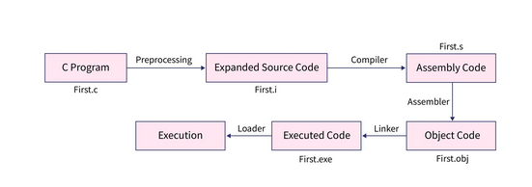

Slide 4
OUTLINE
In this lecture we will cover
  Character set
  Identifiers
  Keyword
  Data types

Slide 5
Language: its influence in our life
Let us look to what we are doing since our childhood, how did we learnt ENGLISH- A recap
A B C D …… X Y Z
Characters
RAT BAT CAT COW
Words
COW EAT GRASS
Statements
ESSAY ON COW
Programs

Slide 6
Introduction to C
Like every language C programming language requires basic building blocks to communicate with the computer.
So we require
  Character set
  Words(keywords and identifiers)
  Statement (instructions)
  Program
Characters
Words
Statements
Programs

Slide 7
Character Set
The character set of C represents alphabet, digit or any symbol used to represent information.
Types | Character Set
Uppercase Alphabets | A, B, C, … Y, Z
Lowercase Alphabets | a, b, c, … y, z
Digits | 0, 1, 2, 3, … 9
Special Symbols | ~ ‘ ! @ # % ^ & * ( ) _ - + = | \ { } [ ] : ; " ' < > , . ? /
White spaces | Single space, tab, new line.

Slide 8
Meaningfulness
Let us look to some words
saslc, enp, keib, rac, llab
Rearrange
Class, pen, bike, car, ball
This is the influence of adding meaning by logical and sensible grouping in mode of communication through language

Slide 9
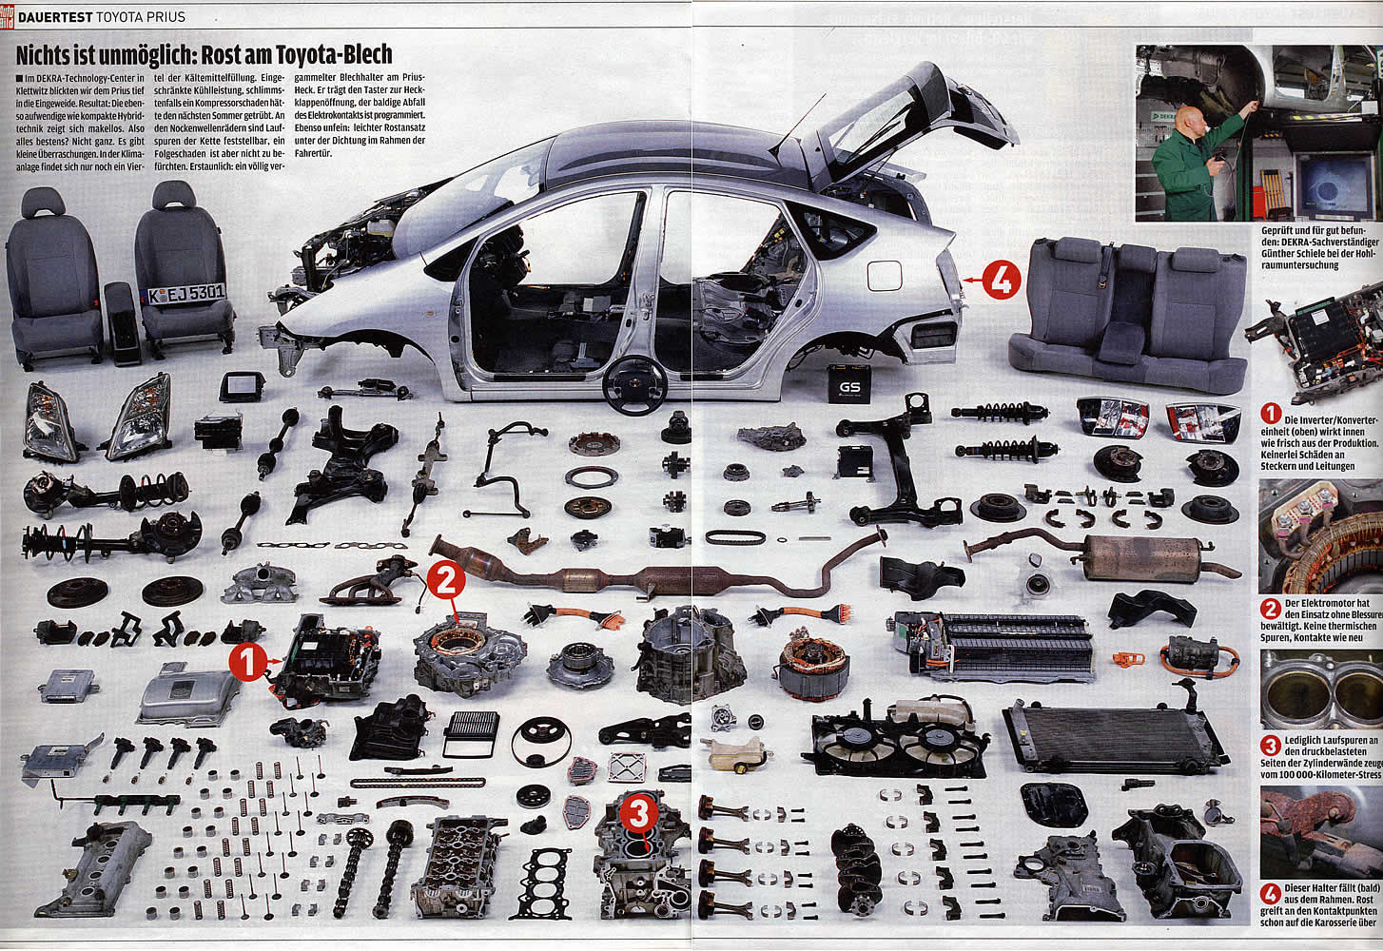
Token
Every single element in a C Program is Token

Slide 10
Token
Smallest unit in a program/statement.
It makes the compiler understand what is written in the program.
Example: main, printf , name,), etc.
Tokens are broadly classified as:
  Identifiers
  Keywords
  Constants
  Variables
  Strings
  Operators
  Special character

Slide 11
Lets Identify the following:
square
circle
ellipse
square
circle
ellipse

Slide 12
Identifiers
So to identify things we have some name given to them .
Identifiers are the fundamental building blocks of a program
Used to give names to variables, functions, constant, and user defined data.
They are user-defined names and consist of a sequence of letters and digits
Notes:
Variable is data name used for storing a data value

Slide 13
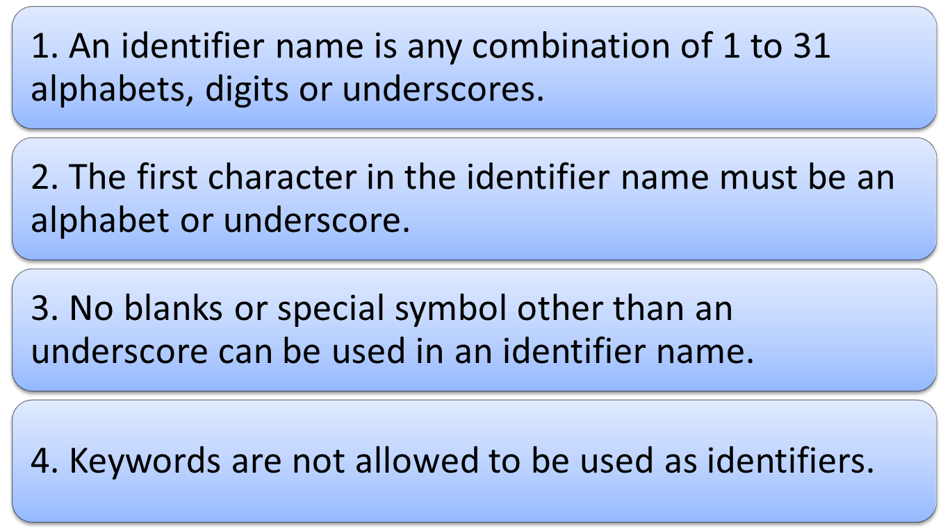
Rules for naming an Identifier

Slide 14

Some Identifiers
Tool_spanner;
tool_spanner;
FORMULA1;
engine_1;
both are different
Wrong identifiers name
1_engine;
break;
@car-roof;

Slide 15
Q Which of the following is not a valid C variable name?
int number;
B) float rate;
C) int variable_count;
D) int $main;

Slide 16

C Keywords
Keywords are the reserved words whose meaning has already been explained to the C compiler.
We cannot use these keywords as variables.
Each keyword is meant to perform a specific function in a C program.
There are 32 keywords in C language.
All keywords are written in lowercase only
Eg: The name of person can never be home, eat, sleep, run, etc because these words have some predefined meaning to perform some task.

Slide 17
List of C Keywords
auto | double | int | struct
break | else | long | switch
case | enum | register | typedef
char | extern | return | union
const | float | short | unsigned
continue | for | signed | void
default | goto | sizeof | volatile
do | if | static | while

Slide 18
Q All keywords in C language are in___
UpperCase letters
LowerCase letters
Digits
CamelCase letters

Slide 19
Q : Identify wrong C Keywords below.
A) union, const, var, float
B) short, unsigned, continue, for
C) signed, void, default, goto
D) sizeof, volatile, do, if

Slide 20
Data Types
Data type means the type of value a variable will have.
It also defines memory space for a particular variable in computer.
The type of value of variable can be alphabets or numbers.
The numbers can be further divided as the integer or rational number.

Slide 21
Lets see a mathematics problem:

Slide 22
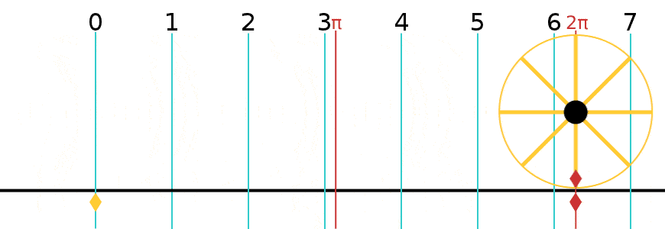
My-Car
If the radius of car wheel is 15inch then what will the distance traveled after one rotation of that wheel?
Sol: Given-
radius = 15
dist_travelled = ?
So, Circumference of circle = 2 * pi * r
dist_travelled = 2 * 3.14 * radius
dist_travelled = 6.28 * 15
dist_travelled = 94.2 Ans.
15
Integer( int in C )
3.14
Real (float in C)
94.2
Real (float in C)

Slide 23
My-Grades
Five students have appeared for Mathematics exam and their respective marks are
84,34,97,58,64
consider the rank bands and their respective grades as
80 to 100 – A
60 to 79 – B
40 to 59 – C
less than 40 – D
So find the grade for each students?

Slide 24
Sol: Given-
M1=84, G1=?
M2=34, G2=?
M3=97, G3=?
M4=58, G4=?
M5=64, G5=?
Marks as integer
Grades as character
84
char in C
A
34
char in C
D
97
A
char in C
C
char in C
58
64
B
char in C

Slide 25
Classification of Data Types
In C data type is broadly classified as:
  Basic data types
  Derived data types
  User defined data types

Slide 26
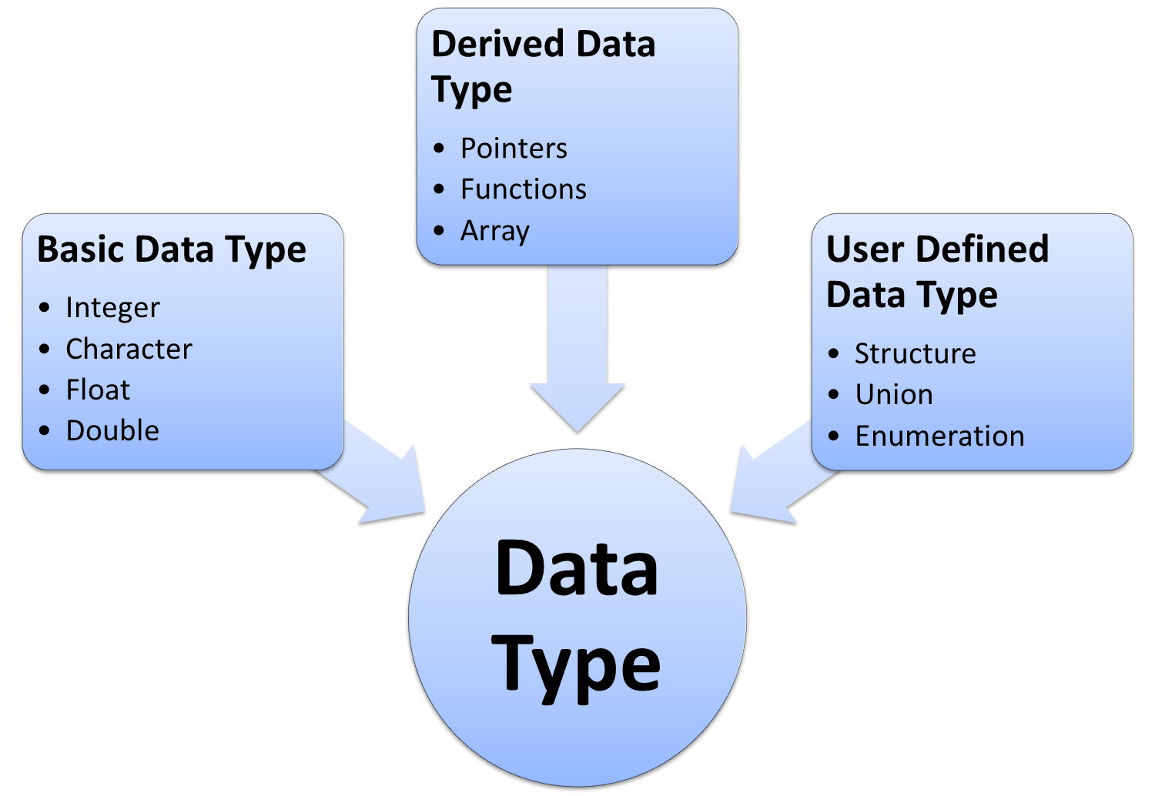

Slide 27
List of Data Types
Type | Size (bytes) | Minimal range
char | 1 | -128 to 127
unsigned char | 1 | 0 to 255
int | 2 or 4 | -32768 to 32767
unsigned int | 2 or 4 | 0 to 65535
short int | 2 | -32768 to 32767
unsigned short int | 2 | 0 to 65535
long int | 4 | -2147483648 to 2147483647
unsigned long int | 4 | 0 to 4294967295
float | 4 | 3.4e-38 to 3.4e+38 with 6 digits of precision
double | 8 | 1.7e-308 to 1.7e+308 with 15 digits of precision
long double | 10 | 3.4e-4932 to 1.1e+4932 with 20 digits of precision

Slide 28

Integer
It is used to store positive and negative counting numbers, as well as zero.
{...,-2,-1,0,1,2,...}
The numbers written in green box of My-Car problem are the integers.
Quick yak:
Some integers used in common are:
No. of steps in staircase
Wheels in an automobile
15
84
34
97

Slide 29
The type modifiers for the integer data type are: signed, unsigned, short, long .
Signed types represent positive and negative numbers.
Unsigned represent zero and positive numbers only.
Long and short represent the range of integer number

Slide 30
Short Integer
Occupies 2 bytes in memory.
Format specifier is %d or %i.
Range is -32768 to 32767.
By default int variable is short signed int.
int cost=100;
short int si;
Long Integer
Occupies 4 bytes in memory.
Format specifier is %ld.
Range is -2147483648 to 2147483647
long radius=123456;
long int value;

Slide 31
Signed Integer
Occupies 2 bytes in memory
Format specifier is %d or %i
There are also long signed integers having range from -2147483648 to 2147483647
Example:
int firstvalue=10;
long int WaterLevel;
Unsigned Integer
Occupies 2 bytes in memory
Format specifier is %u.
There are also long unsigned int with range 0 to 4294967295
Example:
unsigned long count=567898;
unsigned short int page;

Slide 32
Float
Floating point numbers are real numbers that, unlike integers, may contain fractional parts of numbers, like 1.446, -112.972, 3.267e+27.
It is used to store real numbers with single precision i.e. a precision of 6 digits after decimal point.

Slide 33
Format specifier is %f.
The type modifier for float are float, double and long double.
The rational number written in red box of My-Car problem are the float numbers.
3.14
94.2

Slide 34
Type | Float | Double | Long double
Storage Size | 4 byte | 8 byte | 10 byte
Value range | 3.4e-38 to 3.4e+38 | 1.7e-308 to 1.7e+308 | 3.4e-4932 to 1.1e+4932
Precision | 6 decimal places | 15 decimal places | 20 decimal places
Example | pi=3.141592 | 3.141592741012573 | 3.14159265358979323846

Slide 35
Float exam
#include <stdio.h>
int main() {
float myFloatNum = 3.5;
printf("%f\n", myFloatNum); // Default will show 6 digits after the decimal point
printf("%.1f\n", myFloatNum); // Only show 1 digit
printf("%.2f\n", myFloatNum); // Only show 2 digits
printf("%.20f", myFloatNum); // Only show 4 digits
return 0;
}

Slide 36
Example 2
#include <stdio.h>
int main() {
float myFloatNum = 3.5;
double myDoubleNum = 19.99;
printf("%f\n", myFloatNum);
printf("%lf\n", myDoubleNum);
printf("%d", sizeof(myDoubleNum));
return 0;
}

Slide 37
Character
It stores a single character of data belonging to the C character set.
The alphabets written in blue box of My-Grades problem are the character.
A
D
A
B
C

Slide 38
It occupies 1 byte of memory.
Format specifier is %c.
The range is 0 to 255 for unsigned char.
The range is -127 to 127 for signed char.
Each char type has an equivalent integer interpretation, ASCII value, so that a char is really a special kind of short integer.
char choice=‘y’;

Slide 39
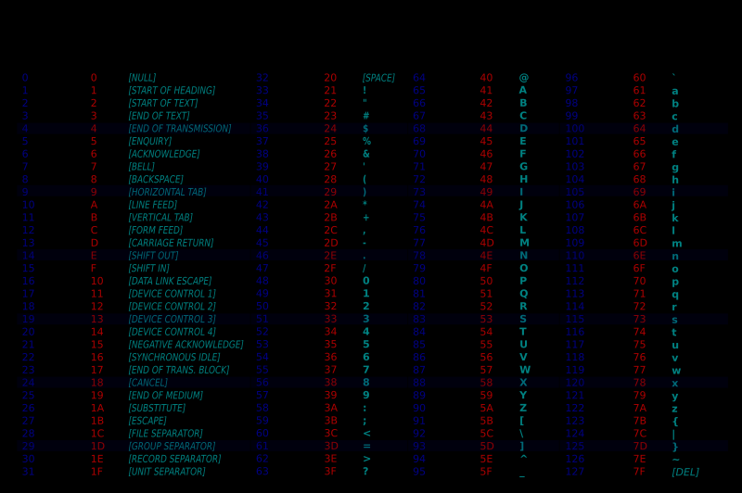

Slide 40
Format Specifier
Specifies the format according to which the value will be printed on screen in C.
Example:
%d : signed integer
%ld: long integer
%u : unsigned integer
%c : single character
%f : float
%s : string
%i : int

Slide 41
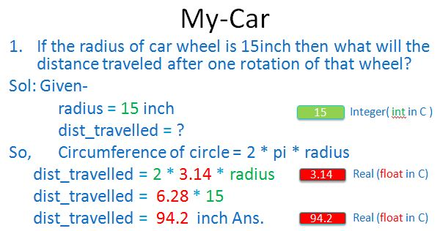
Remember car example?
Program
15
%d
90
%d
3.14
%d
Program
15
%d
94.2
%f
3.14
%f

Slide 42
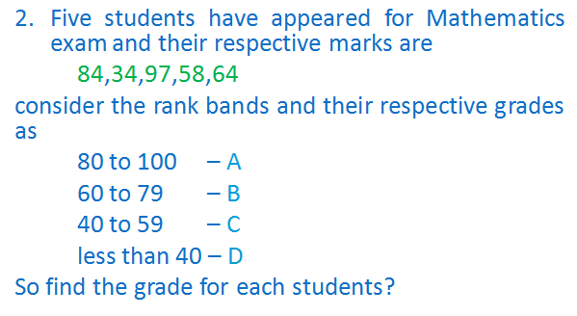
Grade example:
Program
84
%d
%c
A
34
%d
%c
D
97
%d
%c
A
58
%d
%c
C
64
%d
%c
B

Slide 43
Size of float, double and long double in Bytes are.?
A) 4, 8, 16
B) 4, 8, 10
C) 2, 4, 6
D) 4, 6, 8

Slide 44
Ans B

Slide 45
Types of Real numbers in C are.?
A) float
B) double
C) long double
D) All the above

Slide 46
Ans D

Slide 47
Q: Which is correct with respect to size of the datatypes?
A. char > int > float
B. int > char > float
C. char < int < double
D. double > char > int

Slide 48
Ans C

Slide 49
Next Lecture: Constants_x000b_Variables_x000b_Expressions_x000b_Operators

